Slide 1
Final Exam: Review
CS 1714 – Computer Programming II

Slide 2
Variable Declarations - Default Values
There are no default values for variables in C.
Always initialize your variables in C because their default values are indeterminant.
#include<stdio.h>
int main(int argc, char* argv[])
{
int foo = 0;
double bar = 0.0;
char c = 'A';
printf( "This is my first C program\n" );
return 0;
}
You do not need to initialize the variables if you will assign a value later on.

Slide 3
#define and the Preprocessor
#define is resolved BEFORE compilation starts in the preprocessing stage. What happens is that BEFORE compiling the source code to convert it to assembly, the preprocessor will replace all instances of the identifier in our code with the expression that follows it in the #define statement.
#define SCORE 25
int value = SCORE * 15;
/* This statement is what is actually compiled */
int value = 25 * 15;

Slide 4
Booleans in C - Macros Approach
There are a couple ways to use boolean values, when you need to explicitly use true and false.
The macros approach is to use preprocessor directives to define true and false macros as 1 and 0 to represent these "boolean" values
#define TRUE 1
#define FALSE 0

Slide 5
Format Specifiers – printf() Example
These format specifiers are embedded into the printed string within a printf() statement. Then, a list of parameters (variables or expressions) follow that string which will be replaced in the order in which the format specifiers appear. For each format specifier, there needs to be a corresponding parameter of the same type. Here is an example:
int foo = 125;
char bar = 'B';
double value = 3.14159;
printf("Values: %d, %c, %lf", foo, bar, value);
Format specifier and variable listing order matter! They need to match!
Format specifiers
Parameters

Slide 6
scanf()
This code shows how scanf()’s parameters work with the destination variable for the input.
int foobar = 0;
printf("Enter a value: ");
scanf("%d", &foobar);
printf("You entered %d \n", foobar);
Make sure to avoid the use of “\n” or “\t” in scanf

Slide 7
Relational Expressions
Since C evaluates relational expressions to 0 or 1, it is possible to mix other types of expressions like arithmetic and assignment expressions. Consider this if statement where we accidentally left out an equal sign in the equality check.
int foobar = 0;
if(foobar = 0)
{
printf("Foobar is equal to zero.\n");
}
else
{
printf("Foobar is not equal to zero.\n");
}

Slide 8
Ternary Operator
Convert if-else block to a single line, using a conditional expression aka ternary operator
if(condition)
{
myVar = expr1;
}
else
{
myVar = expr2;
}
myVar = (condition) ? expr1 : expr2;

Slide 9
switch case

Slide 10
while Loops in C
while (expression)
{
// Loop body: Executes if expression evaluated to true
// Update the variable in the expression
}
int i = 0;
while(i < 5)
{
printf("%d\n", i);
i++;
}

Slide 11
do-while Loops in C
do
{
// Loop body: Executes if expression evaluated to true
// Update the variable in the expression
} while(expression);
int i = 0;
do
{
printf("%d\n", i);
i++;
} while(i < 5);

Slide 12
for Loops in C
The variable declared in the initialization expression is declared BEFORE the loop
for(initialExpr; conditionExpr; updateExpr)
{
// Loop body
}
int i;
for(i = 0; i < 5; i++)
{
printf("%d\n", i);
}
Be careful! With the loop variable declared before the for loop, it is still in scope even after the loop.

Slide 13
Pattern printing
Given an integer N, write code to print the following pattern. N can be any value. Your code should adapt to the given value and print correspondingly. HINT: find the common pattern.
N=1
*
N=2
*
* | *
N=3
*
* | *
* | * | *
N=4
*
* | *
* | * | *
* | * | * | *
N=5
*
* | *
* | * | *
* | * | * | *
* | * | * | * | *
Empty cells in the table refer to white spaces. While printing, white spaces in the front matter, whereas ones at the end do not matter and need not be printed.

Slide 14
Pattern printing
Given an integer N, write code to print the following pattern. N can be any value. Your code should adapt to the given value and print correspondingly. HINT: find the common pattern.
int i = 0, j = 0, N = 5;
for(i=0; i<N; i++)
{
for(j=0; j<=i; j++)
{
printf("*");
}
printf("\n");
}

Slide 15
Array Size in C
In ANSI C, you need to know the size of the array BEFORE compile-time. This array declaration below is not permitted because we are declaring an array based on this variable length. Because length is inputted during the runtime by the user, it is not known at compile-time, which means it is not ANSI C compliant.
/* This is not permitted in ANSI C */
int length;
scanf("%d", &length);
int array[length];
This code is an example of variable length arrays. It is permitted in C99 and later. Such usage is not permitted in this course.

Slide 16
strcmp()
strcmp() compares two strings. You cannot use == for comparing strings.
It returns 0 if the strings have the same characters. It returns a negative value if str1 is less than str2 and a positive value if str1 is greater than str2 in terms of the ASCII code.
int strcmp(const char* str1, const char* str2)
char color1[] = "red";
char color2[] = "blue";
if( strcmp(color1, color2) == 0)
printf("These strings are the same.\n");
else
printf("These strings are not the same.\n");
/* It will print These strings are not the same. */

Slide 17
strcpy()
strcpy() copies a src string into a dest string. It also returns a pointer to the dest string, but we rarely use the return value. You cannot use = for assigning strings after the initialization.
You need to make the destination string large enough to hold contents of the source string.
char* strcpy(char* dest, const char* src)
char color1[ 10 ];
char color2[] = "blue";
strcpy(color1, color2);
printf("%s %s\n", color1, color2);
/* prints the same string twice */

Slide 18
strlen()
strlen() returns the number of characters up until but not including the null terminator.
The return type of this function is size_t, which is an unsigned integer type. Treat it as an int.
size_t strlen(const char* str)
/* prints out 5 even though there are actually 6 characters including null \0 */
char state[] = "Texas";
int length = strlen(state);
printf("%d\n", length);

Slide 19
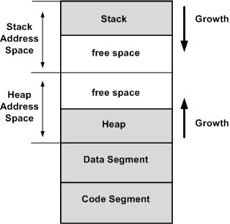
Memory
When you execute a C program, the operating system will allocate memory for your program.
This diagram shows the memory layout of a typical C program.
Memory addresses grow upward. The lowest memory address is at the bottom of the code segment and the highest address is at the top of the stack.
Image source: https://open4tech.com/concept-heap-usage-embedded-systems/

Slide 20
Pointer Example
After the variable declarations, we assign 9 to the variable a. Because ptrA and ptrC point to a’s memory location, it will print out 9 for the dereferenced values of ptrA and ptrC.
a
b
int a = 15;
int b = 18;
int* ptrA = &a;
int* ptrB = &b;
int* ptrC = ptrA;
a = 9;
printf( "%d %d %d", *ptrA, *ptrB, *ptrC );
/* This will print out 9 18 9 */
15 9
18
ptrA
ptrC
ptrB

Slide 21
Pointer Example
Because ptrA and ptrC point to a’s memory location, there are three possible ways to change the value in that memory location.
int a = 15;
int b = 18;
int* ptrA = &a;
int* ptrB = &b;
int* ptrC = ptrA;
a = -9;
int a = 15;
int b = 18;
int* ptrA = &a;
int* ptrB = &b;
int* ptrC = ptrA;
*ptrA = -9;
int a = 15;
int b = 18;
int* ptrA = &a;
int* ptrB = &b;
int* ptrC = ptrA;
*ptrC = -9;

Slide 22
Pointer Variables with Arrays
In this example, since ptr points to the memory address of the first item of array, we can use the pointer variable to access the array as well. That is, we can treat ptr like an array with the subscript operator.
int array[] = { 7, 9, 34, 0, 12 };
int* ptr = array;
int i;
for(i = 0; i < 5; i++)
{
ptr[i] += 10;
printf("%d\n", ptr[i]);
}
int array[] = { 7, 9, 34, 0, 12 };
int* ptr = array;
int i;
for(i = 0; i < 5; i++)
{
array[i] += 10;
printf("%d\n", array[i]);
}
has the same effect as
Both variables array and ptr refer to the same array. So it’s possible to change the array values through either variable.

Slide 23
Arrays and Pointers
We can create pointer variables to point at different parts of the array. The first approach is to assign the pointer to the memory address of the array index using reference operator and subscript operator. The second approach is to assign the pointer to the array variable (without the subscript operator) plus an offset. Both the index and offset refer to the same element.
int array[] = { 7, 9, 34, 0, 12 };
/* ptr is pointing at the memory
address of array[4] */
int* ptr = &array[4];
int array[] = { 7, 9, 34, 0, 12 };
/* ptr is pointing at the memory
address of four items away from
first item of the array */
int* ptr = array + 4;
Both examples are pointing at the memory address of the array[4].

Slide 24
Exercise
It is a standard for-loop traversal of an array, but using the dereferencing and the offset notation to access the array elements.
int array[SIZE] = { 10, 20, 30, 40, 50, 60 };
int i = 0;
int* ptr = array;
for(i = 0; i < SIZE; i++)
printf("%d ", *(ptr + i));
After this loop, ptr is still pointing at the beginning of the array.
We have to parenthesize the offset (ptr + i) first before dereferencing. Otherwise, *ptr + i means to dereference and then add i to the value.

Slide 25
Exercise
Here is another approach where ptr changes to another memory address.
int array[SIZE] = { 10, 20, 30, 40, 50, 60 };
int i = 0;
int* ptr = array;
for(i = 0; i < SIZE; i++)
printf("%d ", *ptr++);
Remember right-to-left evaluation: *(ptr++). The post-increment happens to the pointer and not the dereferenced value of the pointer. We are actually moving the ptr along the array.

Slide 26
Pointer Arithmetic (Theoretical / Paper) Example – 1
Trace the following code. Show the starting address, the intermediate and final values of the variables at each step. char values are 1 byte, int are 4 bytes, double are 8 bytes, any type of pointer variables are 8 bytes. Assume that the starting address is 1000.
Variable Name | Starting Address | Value
X | 1000 | 20
Y | 1004 | 30
Z | 1008 | 40
p | 1012 | 1020 1024 1028 1032
arr[0] | 1020 | 6 10
arr[1] | 1024 | 5
arr[2] | 1028 | 4
arr[3] | 1032 | 3 20
arr[4] | 1036 | 2
int X = 20, Y = 30, Z = 40;
int* p;
int arr[5] = { 6, 5, 4, 3, 2 };
p = arr;
*p++ = 10;
p = &arr[2];
*++p = 20;

Slide 27
malloc Example
In this example, we don’t know the size of the array at compile time. We ask the user to enter the size and then dynamically allocate an array for that size.
It then fills the array with values from the user.
At the end of the program, we deallocate the array.
int* ptr;
int num;
int i;
printf("Enter the number of items: ");
scanf("%d", &num);
ptr = (int*)malloc(num * sizeof(int));
for(i = 0; i < num; i++)
{
ptr[i] = i * 5;
printf("%d\n", ptr[i]);
}
free(ptr);

Slide 28
Function – Pass-by-Value
By default, parameters are passed by value (like in Java).
A copy of the actual parameter’s value is passed to the function.
int main(int argc, char* argv[])
{
int foobar = 0;
doSomething(foobar);
/* actual parameter foobar does not
change from this function call.
This prints 0 */
printf(“%d”, foobar);
}
void doSomething(int x)
{
x = 1000;
}

Slide 29
Function – Pass-by-Pointer
To call this function, we need to pass the memory address of the actual parameter using the reference & operator.
The memory address of foobar is passed to the function.
int main(int argc, char* argv[])
{
int foobar = 0;
doSomething(&foobar);
/* actual parameter foobar is
changed after this function call. This prints 1000 */
printf(“%d”, foobar);
return 0;
}
void doSomething(int* x)
{
*x = 1000;
}
Change the contents of what x is pointing at to 1000.
This is how scanf() works.

Slide 30
Example – Pass by Value/Pointer
#include <stdio.h>
double computeSq(double);
void posVal(double*);
int main(int argc, char* argv[])
{
double x;
printf("Enter value : ");
scanf("%lf”, &x);
printf("Square of %lf is %lf\n", x, computeSq(x));
return 0;
}
double computeSq(double x)
{
double sq = 0;
posVal(&x);
sq = x*x;
return sq;
}
void posVal(double* x)
{
if(*x < 0)
*x = 0;
}

Slide 31

Two Approaches for Declaring a struct
You can declare a struct with OR without a typedef.
/* Original Approach without the typedef */
struct Product
{
char name[100];
double price;
int quantity;
};
// Usage
struct Product myProduct;
/* Approach with typedef */
typedef struct Product
{
char name[100];
double price;
int quantity;
} Product;
// Usage
Product myProduct;
We will use the typedef approach.

Slide 32
Using a struct
To access each data member in the struct, we need the name of the struct variable, a period, and the desired data member (the variable's identifier). Here are examples of accessing the data members.
Product myProduct;
myProduct.price = 1.25;
myProduct.quantity = 100;
strcpy(myProduct.name, "Apples");
printf("%s: %d\t %.2lf\n", myProduct.name, myProduct.quantity, myProduct.price);
You need to initialize all the data members.

Slide 33
Dynamic Allocation of a Single struct object
The major difference now is how we access the data member of a single, dynamically allocated struct object. We need the name of the struct variable, the arrow operator ->, and the desired data member. As always, initialize all data members before use.
Product* p;
p = (Product*)malloc(sizeof(Product));
p->price = 1.25;
p->quantity = 10;
strcpy(p->name, "Apples");
printf( "%s: %d\t %.2lf\n", p->name, p->quantity, p->price);

Slide 34
Dynamic Allocation of an Array of struct’s
Dynamic allocation of an array of struct objects follows the same syntax as a dynamic allocation of an array of primitive data types.
In this example, we will dynamically allocate an array of 10 Product struct objects. We just have to multiply the sizeof() expression by the number of items we want.
Product* p;
p = (Product*)malloc(10 * sizeof(Product));

Slide 35
Dynamic Allocation of an Array of struct’s
Accessing the data members of a struct object within a dynamically allocated array of struct objects follows the same syntax as a regular struct array. We need the subscript operator for the struct array and use the dot notation to access the data member.
Product* p;
p = (Product*)malloc(10 * sizeof(Product));
p[0].price = 1.25;
p[0].quantity = 100;
strcpy(p[0].name, "Apple");
p[1].price = .79;
p[1].quantity = 200;
strcpy(p[1].name, "Banana");

Slide 36
FILE
r - reads a file
w - creates a new file, delete the contents if the file exists
a – appends to the end of the file
r+ - reading and writing
w+ - reading and writing, delete the contents if the file exists
FILE refers to a file and describes the current state of the file. To open a file, use these statements:
You should close the file when you are done with it.
FILE* fileptr = NULL;
fileptr = fopen("textfile.txt", "r");
/* always check to see if the file opens */
if(fileptr == NULL)
{
printf("Couldn't open file");
return 1;
}
fclose(fileptr);

Slide 37
Reading from a File
There are three file functions that will help you read through a file. In selecting one, you need to know the structure of the file AND what the goal of your program is. Usually, you use them in some indefinite loop to read through the entire file.
/* gets the next character in the stream */
int fgetc(FILE* stream)
/* gets the next line up to n - 1 characters in the stream */
char* fgets(char* str, int n, FILE* stream)
/* reads in a formatted input from the stream,
useful if you have a structured file */
int fscanf(FILE* stream, const char* format, ...)

Slide 38
File Input Functions
Here are some scenarios that can help you get started on when to use any of the three functions. Remember we usually use these functions with loops.
Function | Scenario
fgetc() | You need to read one character or one byte of information at a time regardless of how the file contents are structured. This may later require putting those characters back together.
fgets() | You need to read one line (or paragraph) at a time OR X number of characters at a time. This line may require further parsing.
fscanf() | You need to read one int, double, or string at a time OR you are reading a highly structured file (with a pattern).

Slide 39
fgetc()
This example shows how to read in from a file by character. It uses an infinite while loop. Each iteration reads in one character with fgetc().
/* using fgetc() */
char a;
while(1)
{
a = fgetc(fileIn);
if(a == EOF)
break;
printf("%c\n", a);
}
When it encounters the EOF (end of file), the loop will break.
Otherwise, it will print out the character. It is at this point you would do whatever computation or analysis is needed with that character.
EOF is defined as -1.

Slide 40
fgets()
This example shows how to read in from a file using fgets(). It uses a while loop to keep reading until it cannot read anymore, when fgets() returns NULL.
#define LENGTH 500
Make sure the string length is the same or less than the fgets() second parameter. Here we have a macro to make sure we match.
/* using fgets() */
char buffer[LENGTH];
while(fgets(buffer, LENGTH, fileIn) != NULL)
{
printf("%s\n", buffer);
}
fgets() reads up to the number of characters in the second parameter or new line.

Slide 41
fscanf()
This example code shows how to read in from a file using fscanf(). The format specifier string should match the structure/organization of the input file. fscanf() returns the number of values it was able to convert to those format specifiers. The while loop keeps reading in the file so long as it can read in the file content that match the format specifier string. We are assuming there is a pattern to the types.
Only use this code when you know the actual structure of your input file. Here, each line has a string followed by an integer followed by a double, all separated by a space.
/* read formatted line using fscanf() */
char arg1[100];
int arg2;
double arg3;
while(fscanf(fileIn, "%s %d %lf", arg1, &arg2, &arg3) == 3)
{
printf("%s %d %lf\n", arg1, arg2, arg3);
}
Notes:
Fgets puts it in the buffer

Slide 42

rewind()
The file pointer keeps track of the current position of where you are in the file. As you use the file input functions, the position will go further down the file.
In the event you want to return to the beginning of the file, you can rewind the pointer back to the beginning of the file using rewind().
char buffer[500];
while(fgets(buffer, 500, fileIn) != NULL)
printf("%s\n", buffer);
/* rewinds the file pointer fileIn back to the beginning of the file */
rewind(fileIn);
rewind() does not tell you if it was successful as it is a void function.

Slide 43

Writing to a File
Use fprintf() to write to a file. It works like printf(), but you need to also pass in the file pointer as its first parameter.
Example
int fprintf(FILE* stream, const char *format, ...)
char line[100];
printf("Enter a line: ");
scanf("%s", line);
/* assuming you have defined FILE* fileOut to
refer to a file opened for writing */
fprintf(fileOut, "%s\n", line);

Slide 44

Comma Separated Values
CSV (comma-separated value) files is a standard format for storing data in a tabular format. CSV files are stored in a plain-text format and can be viewed in any text editor (e.g., vim) and can even be opened in Excel. CSV files are a popular way for agencies to share data online.
When you look at a CSV file, you will see rows of data where each row has several values separated by commas. Here is an example of a CSV file of a list of product inventory. Each row has the product name, quantity, and price separated by commas. In this example, there is also a header row, which is optional, telling us what each “column” is.
product,quantity,price
Apple,10,1.25
Banana,28,.99
Orange,150,1.79

Slide 45
Using sscanf() with fgets()
Here is an example of how to use sscanf() and fgets() to read in each CSV row and parse out the data. In this case, we are just printing out these individual values, but you can also use them or save them for further analysis.
/* read formatted line using fgets() and sscanf() */
char buffer[1024];
int arg2;
double arg3;
while(fgets(buffer, 1024, fileIn) != NULL)
{
sscanf(buffer, "%d,%lf", &arg2, &arg3);
printf("%d %lf\n", arg2, arg3);
}
Here, each CSV row has an integer followed by a double separated by a comma.
Notice the comma is also in the sscanf() statement.
Notes:
Fgets puts it in the buffer

Slide 46
Using sscanf() with commas
If your CSV row involves a string, you cannot simply use %s in sscanf() to get a column of information. It will treat the commas and all other characters in that row as part of the string and therefore, reads in the rest of the line.
We have to use a special token in sscanf to grab everything until the first comma: %[^,]. This format specifier allows us to read in a string up to but not including the comma.
char buffer[1024];
char arg1[100];
int arg2;
double arg3;
while(fgets(buffer, 1024, fileIn) != NULL)
{
sscanf(buffer, "%[^,],%d,%lf", arg1, &arg2, &arg3);
printf("%s %d %lf\n", arg1, arg2, arg3);
}
Notice the comma is also in the sscanf() statement.

Slide 47
Using Command Line Arguments
You can use command line arguments to specify what tasks you want your program to run, what files to input, what files to output to, etc.
/*
This program just lists all the arguments passed in
in the command line
*/
int main(int argc, char* argv[])
{
int i = 0;
printf("You have %d command line arguments.\n", argc);
for(i = 0; i < argc; i++)
{
printf("argument %d: %s\n", i, argv[i]);
}
}
Output:
$ ./a.out cmd1 123
You have 3 command line arguments.
argument 0: ./a.out
argument 1: cmd1
argument 2: 123
Notice that the executable name includes the ./ and that all arguments are treated as strings, even the 123.

Slide 48
Makefiles
You need a make rule for each object file as determined by each source file. List out all the prerequisites this source file has.
Consider the following file dependencies in your project. Create a makefile with ‘myprogram’ as the output executable name.
main.c -> myfunctions.h
myfunctions.c -> myfunctions.h
You do not actually need to use the -o option in the individual gcc commands for the individual source files. They were included to make explicitly sure what the object file names will be.
clean commands will remove any files generated by this Makefile program (.o files and the executable).
myprogram: main.o myfunctions.o
gcc main.o myfunctions.o -o myprogram
main.o: main.c myfunctions.h
gcc -c main.c -o main.o
myfunctions.o: myfunctions.c myfunctions.h
gcc -c myfunctions.c -o myfunctions.o
clean:
rm -rf *.o
rm myprogram
Make recipes require a tab. Regular vim tabs do NOT work! To force a tab in vim, be in Insert Mode, hit CTRL+V, and then tab.

Slide 49
Factorial Example – Math Notation
5! = 5 * 4 * 3 * 2 * 1
4! = 4 * 3 * 2 * 1
3! = 3 * 2 * 1
2! = 2 * 1
1! = 1 ← no more recursion is needed
Generalized to N! = N * ( N - 1 )!
is the same as 5! = 5 * 4!
is the same as 4! = 4 * 3!
is the same as 3! = 3 * 2!
is the same as 2! = 2 * 1!
Recall that recursion is solving the larger problem by solving the smaller problems using the same approach and putting the solutions together

Slide 50
Factorial Example in Function Form
Let’s assume you wrote a function factorial() that returns the factorial of a number passed in: int factorial( int n )
factorial( 5 ) → 5 * factorial( 4 );
factorial( 4 ) → 4 * factorial( 3 );
factorial( 3 ) → 3 * factorial( 2 );
factorial( 2 ) → 2 * factorial( 1 );
factorial( 1 ) → 1; ← no more recursion is needed
Generalized to factorial( n ) → n * factorial( n - 1 );
The function call is dependent on a call to itself!

Slide 51
A Recursive Function
Recursion is when a function calls itself directly or indirectly
When calling recursiveFunction(3), recursiveFunction(2) is called. recursiveFunction(2) is not done until recursiveFunction(1) is done.
int recursiveFunction(int n)
{
if(n == 1)
{
return 1;
}
return n * recursiveFunction(n – 1);
}
Base case. When the function no longer calls itself (no further computations are needed). This decision is usually based on the value of a parameter.
Recursive call. When the function calls itself. Usually, the recursive function involves passing in an updated value of a parameter. You want to make sure that however you change that parameter, you can eventually get to the base case.

Slide 52
Consider the following code for a recursive function. Give the output value for the different function calls to this function.
rec(5), rec(6), rec(2)
int rec(int n)
{
if(n < 0)
return 0;
return n + rec(n - 2);
}
rec(5) = 9
rec(6) = 12
rec(2) = 2

Slide 53
Write a recursive function that calculates the factorial of a given number.
A factorial of a number N is the product of all whole numbers between N and 1.
E.g. factorial(5) = 5*4*3*2*1 = 120
factorial(n) = n * factorial(n – 1)
factorial(1) = 1
int factorial(int n)
{
if(n == 1)
return 1;
return n * factorial(n – 1);
}

Slide 54
Use the down arrow to step through the trace in Slide Show
// Function to calculate n factorial
int g(int n)
{
int res;
if(n<=1)
res = 1;
else
res = n * g(n-1);
return res;
}
g(5) from main function
120
g
24
g
6
g
2
g
1
g
n = 5
res
n = 4
res
n = 3
res
n = 2
res
n = 1
res
120
5*24=120
4*6=24
3*2=6
2*1=2
1

Slide 55
Write a recursive function that returns the ‘n’th number in the Fibonacci Sequence. A Fibonacci sequence starts from 0,1 and all following numbers are the sum of the previous two numbers in the sequence.
0, 1, 1, 2, 3, 5, 8, 13, 21, 34, 55, 89, 144, 233, …
int fib(int n)
{
switch (n)
{
case 0:
case 1:
return n;
default:
return fib(n-1) + fib(n-2);
}
}
fib(n) = fib(n-1) + fib(n-2)
fib(0) = 0 AND fib(1) = 1

Slide 56
// Function to calculate ‘n’th value of Fibonacci sequence
// 0,1,1,2,3,5,8,13,21,34,55,89,144,233
Use the down arrow to step through the trace in Slide Show
int fib(int n)
{
switch (n)
{
case 0:
case 1:
return n;
default:
return fib(n-1) + fib(n-2);
}
}
fib(4) from main function
3
1=3
fib
2+
n = 4
1=2
fib
1+
n = 3
0=1
fib
1+
n = 2
0=1
fib
1+
1
fib
n = 2
n = 1
1
fib
0
fib
n = 1
n = 0
1
fib
0
fib
n = 1
n = 0

Slide 57
Write a recursive function that returns the MIN of an array.
E.g. int arr[] = {25,100,1,45,50}; n = 5
If n = 1, min = arr[0] Recursively reduce the array by one
int min(int arr[], int n)
{
if(n == 1)
return arr[0];
else
{
int t = min(arr+1, n-1);
if(arr[0] < t)
return arr[0];
else
return t;
}
}

Slide 58
// Function to calculate the MIN of a given array
// int arr[] = {25,100,1,45,50};
Use the down arrow to step through the trace in Slide Show
int g(int arr[], int n)
{
if(n==1)
return arr[0];
else
{
int t = g(arr+1,n-1);
if(arr[0] < t)
return arr[0];
else
return t;
}
}
g(arr, 5) from main function
1
g
1
g
1
g
45
g
50
g
n = 5
t =
n = 4
t =
n = 3
t =
n = 2
t =
n = 1
t =
1
45
50
1
1
-
ARRAY
{25,100,1,45,50}
{100,1,45,50}
{1,45,50}
{45,50}
{50}

Slide 59
Linear Search
What’s the best case scenario in terms of how many items it has to check in the array?
// go through the entire array and find the key
// return the index where the key is found
// return -1 if it is not found.
int linearSearch(int* array, int size, int key)
{
int i=0;
for(i=0; i<size; i++)
{
if(array[i] == key)
return i;
}
return -1;
}
What’s the worst case scenario in terms of how many items it has to check in the array?
Time Complexity = O(n)
Space Complexity = O(1)
‘n’ being the size of the array

Slide 60
Binary Search Code
int binarySearch(int arr[], int n, int key)
{
int mid, low=0, high=n-1;
while(low <= high)
{
mid = (high + low) / 2;
if(arr[mid] < key)
low = mid + 1;
else if(arr[mid] > key)
high = mid - 1;
else
return mid;
}
return -1; // not found
}
Every iteration of the loop will have a new high OR low value. Eventually, the loop will stop because it didn’t find OR because it return the index of where it found it.

Slide 61
Searching for 18
0 | 1 | 2 | 3 | 4 | 5 | 6 | 7 | 8 | 9 | 10 | 11 | 12 | 13
10 | 12 | 15 | 18 | 22 | 28 | 35 | 59 | 60 | 62 | 65 | 70 | 80 | 81
Check | Low Index | High Index | Mid Index | Mid Value | Found?
1 | 0 | 13 | 6 | 35 | No
2 | 0 | 5 | 2 | 15 | No
3 | 3 | 5 | 4 | 22 | No
4 | 3 | 3 | 3 | 18 | Yes, Done
The binary search function will return the last mid value, which is 3.

Slide 62
Recursive Binary Search Code
int RBS(int arr[], int low, int high, int key)
{
if(low <= high)
{
int mid = (high + low) / 2;
if(arr[mid] == key)
return mid;
if(arr[mid] > key)
return RBS(arr, low, mid – 1, key);
else
return RBS(arr, mid+1, high, key);
}
return -1; // not found
}
Time Complexity = O(log₂N)

Slide 63
Four Sorting Algorithms
All four sorting algorithms go through the array, compare and swap values to put them in order
Bubble sort – for each element, it swaps adjacent elements to order
Selection sort – maintains a "sorted" array, created by finding the next smallest value’s index in the remaining part of the array (unsorted array)
Insertion sort – maintains a "sorted" array, created by taking the next value from the unsorted and inserting it into the "sorted array"
Merge sort – keep dividing array into partitions, then merge them together in order

Slide 64
Bubble Sort
0 1 2 3 4
BEFORE: 28 17 15 30 12
i = 0, j = 0 28 17 15 30 12
i = 0, j = 1 17 28 15 30 12
i = 0, j = 2 17 15 28 30 12
i = 0, j = 3 17 15 28 30 12
i = 1, j = 0 17 15 28 12 30
i = 1, j = 1 15 17 28 12 30
i = 1, j = 2 15 17 28 12 30
i = 2, j = 0 15 17 12 28 30
i = 2, j = 1 15 17 12 28 30
i = 3, j = 0 15 12 17 28 30
AFTER: 12 15 17 28 30
// consider int arr[] = {28, 17, 15, 30, 12}
void bubbleSort(int arr[], int n)
{
int i, j, t;
for(i=0; i<n-1; i++)
{
for(j=0; j<n-i-1; j++)
{
if(arr[j] > arr[j+1])
{
t = arr[j];
arr[j] = arr[j+1];
arr[j+1] = t;
}
}
}
}
Bubble sort “bubbles” the largest element to the end of the array by swapping each pair of adjacent elements.
At the end of each iteration of the outer loop, you should have the greater values in order at the end.
Bubble sort goes through each item and swaps with the adjacent elements: if the next item is less than the current item, swap it.

Slide 65
Selection Sort
0 1 2 3 4
BEFORE: 28 17 15 30 12
i = 0 28 17 15 30 12 sm = 4
i = 1 12 17 15 30 28 sm = 2
i = 2 12 15 17 30 28 sm = 2
i = 3 12 15 17 30 28 sm = 4
AFTER: 12 15 17 28 30
// consider int arr[] = {28, 17, 15, 30, 12}
void selectionSort(int arr[], int n)
{
int i, j, t, smallestIndex;
for(i=0; i<n-1; i++)
{
smallestIndex = i;
for(j=i+1; j<n; j++)
{
if(arr[j] < arr[smallestIndex])
smallestIndex = j;
}
t = arr[i];
arr[i] = arr[smallestIndex];
arr[smallestIndex] = t;
}
}
Selection sort “selects” the smallest element from the unsorted part and places it to the front sorted part.
Selection sort treats the input as two parts, a sorted part and an unsorted part. It repeatedly selects the smallest value from the unsorted part and moves it to the end of the sorted part.

Slide 66
Insertion Sort
0 1 2 3 4
BEFORE: 28 17 15 30 12
i = 1 28 17 15 30 12
i = 2 17 28 15 30 12
i = 3 15 17 28 30 12
i = 4 15 17 28 30 12
AFTER: 12 15 17 28 30
// consider int arr[] = {28, 17, 15, 30, 12}
void insertionSort(int arr[], int n)
{
int i, j, key;
for(i=1; i<n; i++)
{
key = arr[i];
j = i-1;
while(j >= 0 && arr[j] > key)
{
arr[j+1] = arr[j];
j--;
}
arr[j+1] = key;
}
}
Insertion sort treats the input as two parts, a sorted part and an unsorted part. It repeatedly inserts the next value from the unsorted part to the correct location in the sorted part.
Insertion sort “inserts” the element from the unsorted part and places it to the correct location in the sorted part.

Slide 67
Merge Sort Function
0 | 1 | 2 | 3 | 4 | 5 | 6 | 7
32 | 19 | 40 | 17 | 80 | 84 | 24 | 25
0 | 1 | 2 | 3
32 | 19 | 40 | 17
4 | 5 | 6 | 7
80 | 84 | 24 | 25
0 | 1
32 | 19
2 | 3
40 | 17
4 | 5
80 | 84
6 | 7
24 | 25
0
32
1
19
2
40
3
17
4
80
5
84
6
24
7
25

Slide 68
Merge Function
Merge sort is harder to implement, but its run time complexity is O(N*logN).
0 | 1 | 2 | 3 | 4 | 5 | 6 | 7
17 | 19 | 24 | 25 | 32 | 40 | 80 | 84
0 | 1 | 2 | 3
17 | 19 | 32 | 40
4 | 5 | 6 | 7
24 | 25 | 80 | 84
0 | 1
19 | 32
2 | 3
17 | 40
4 | 5
80 | 84
6 | 7
24 | 25
0
32
1
19
2
40
3
17
4
80
5
84
6
24
7
25

Slide 69
Merge Sort
void mergeSort(int arr[], int low, int high)
{
if(low < high)
{
// Find the midpoint in the partition
int mid = (low + high) / 2;
// Recursively sort the left half
mergeSort(arr, low, mid);
// Recursively sort the right half
mergeSort(arr, mid+1, high);
// Merge the halves in sorted order
merge(arr, low, mid, high);
}
}
Merge sort uses divide and conquer.
It divides the array into two halves.
Recursively sorts each half.
Merges the sorted halves in sorted order.
"Partitioning the array" really means to just focus on a subset between the indices low & high.

Slide 70
Merge Sort – merge function
Merge sort uses a second function to merge two partitions together after the recursive calls are complete.
void merge(int arr[], int low, int mid, int high)
{
int s = high-low+1;
int temp[s];
int t=0, l=low, r=mid+1;
while(l <= mid && r <= high)
{
if(arr[l] <= arr[r])
temp[t++] = arr[l++];
else
temp[t++] = arr[r++];
}
while(l <= mid)
temp[t++] = arr[l++];
while(r <= high)
temp[t++] = arr[r++];
for(t=0; t<s; t++)
arr[low+t] = temp[t];
}

Slide 71
Sorting an Array of struct Objects
void bubbleSort(Student arr[], int n)
{
int i, j, t;
for(i=0; i<n-1; i++)
{
for(j=0; j<n-i-1; j++)
{
if(arr[j] > arr[j+1])
{
t = arr[j];
arr[j] = arr[j+1];
arr[j+1] = t;
}
}
}
}
If you have an array struct objects, you need to determine which of its data members is the one you will sort by.
Your comparison will have to be against the data member you are using to sort by.
(arr[j].gpa > arr[j+1].gpa)
t = arr[j+1].gpa;
arr[j].gpa = arr[j+1].gpa;
arr[j+1].gpa = t;
When a swap occurs, it’s copying over every data member (using assignments and strcpy’s).
Notes:
Very basic sort

Slide 72
Sorting Algorithms – Run Time Efficiency
O( 1 ) | 🤩
O( log n ) | 😃
O( n ) | 😐
O( n log n ) | 😑
O( n² ) | 😡
O( 2^{n} ) | 😡😱
O( n! ) | 😡😱🤯
Sort | Run Time Complexity | Translation
Bubble | O( n² ) | 😡
Selection | O( n² ) | 😡
Insertion | O( n² ) | 😡
Merge | O( n log n ) | 😑

Slide 73
Linked Lists
A linked list is a data structure comprised of a linear set of nodes. The most basic linked list is a singly linked list (shown here)
Each node has some data and a pointer to the next node.
The data may include many data members. At least one of those data members is a pointer to the next node. The last node’s next pointer points to NULL (that’s how we know we’re at the end).
In C, each node is defined by a struct and is dynamically allocated.
A linked list is usually referred to by the first item, also known as the head.
head
Data
Data
Data
Data
NULL

Slide 74
Linked Lists versus Arrays
Linked lists can grow in size as each node is dynamically allocated while array sizes are fixed.
It easier to access a specific element in an array with an index number whereas you may have to entirely traverse a linked list first.
Array values are stored in a contiguous block of memory. Memory is dynamically allocated for linked list nodes, so the nodes don’t have to exist in a contiguous block of memory.
vs.

Slide 75
Typical struct Declaration for a Linked List Node
/* Example 1 */
typedef struct Node
{
int value1;
int value2;
struct Node* next;
} Node;
/* Example 2 */
typedef struct Airport
{
char code[4];
double latitude;
double longitude;
struct Airport* next;
} Airport;
struct keyword is needed here
This is similar to creating a struct for our array of struct’s except that each struct object has a pointer to another struct object.

Slide 76
Linked List createNode() function
typedef struct Node
{
int val;
struct Node* next;
} Node;
Node* head = NULL;
Node* n1 = createNode(10);
Node* n2 = createNode(20);
head = n1;
n1->next = n2;
/* Create Node function */
Node* createNode(int v)
{
Node *n = (Node*)malloc(sizeof(Node));
n->val = v;
n->next = NULL;
return n;
}

Slide 77
Print a Linked List
void print(Node* head)
{
Node* t = head;
while(t != NULL)
{
printf(“%d -> ”, t->val);
t = t->next;
}
printf(“\n”);
}

Slide 78
Length of a Linked List
int length(Node* head)
{
int n=0;
Node* t = head;
while(t != NULL)
{
t = t->next;
n++;
}
return n;
}

Slide 79

Garbage Collection – Destroy Linked List
When your program is done with the linked list, you should deallocate the memory for all the nodes.
/* Destroying a linked list */
void destroy(Node* head)
{
while(head != NULL)
{
Node* t = head;
head = head->next;
free(t);
}
}

Slide 80
Inserting into a Linked List
There are 3 ways to add or insert a new node into a linked list:
Prepend - add to the front (using the head).
Append - add to the end. You must traverse the linked list starting with the head to get to the last node before adding.
InsertSortedOrder – add a new node somewhere in the center of the linked list while inserting the nodes in sorted order. You must first find the position where the node needs to be inserted. Once you are at the insert position, you must modify the next pointers of the new node and the surrounding nodes currently in the linked list.

Slide 81
Prepending to a Linked List
Prepending or inserting at the front is the easiest approach since it only involves working with the head of the linked list.
Dynamically allocate the new node
newNode
Data
NULL
head
Data
Data
Data
Data
NULL

Slide 82
Prepending to a Linked List
Prepending or inserting at the front is the easiest approach since it only involves working with the head of the linked list.
Dynamically allocate the new node
Make the new node’s next pointer point to the same node as the head
newNode
Data
head
Data
Data
Data
Data
NULL

Slide 83
Prepending to a Linked List
Prepending or inserting at the front is the easiest approach since it only involves working with the head of the linked list.
Dynamically allocate the new node
Make the new node’s next pointer point to the same node as the head
Make head point at the new node
Data
head
Data
Data
Data
Data
NULL

Slide 84
Prepending to a Linked List
Here is the code to Prepend a new node to a linked list
typedef struct Node
{
int val;
struct Node* next;
} Node;
Node* head = NULL;
head = prepend(head, 10);
head = prepend(head, 20);
Node* prepend(Node* head, int v)
{
Node* n = createNode(v);
n->next = head;
return n;
}

Slide 85
Appending to a Linked List
Appending refers to inserting a new node at the end of the linked list.
Dynamically allocate the new node
newNode
Data
NULL
head
Data
Data
Data
Data
NULL

Slide 86
Appending to a Linked List
Appending refers to inserting a new node at the end of the linked list.
Dynamically allocate the new node
Initialize a temp pointer ‘t’ at the head
t
newNode
Data
NULL
head
Data
Data
Data
Data
NULL

Slide 87
Appending to a Linked List
Appending refers to inserting a new node at the end of the linked list.
Dynamically allocate the new node
Initialize a temp pointer ‘t’ at the head
Move the pointer ‘t’ to the end of the list
newNode
Data
NULL
head
Data
Data
Data
Data
NULL
t

Slide 88
Appending to a Linked List
Appending refers to inserting a new node at the end of the linked list.
Dynamically allocate the new node
Initialize a temp pointer ‘t’ at the head
Move the pointer ‘t’ to the end of the list
Make the next pointer for ‘t’ (t->next) to point to the newNode
newNode
Data
NULL
head
Data
Data
Data
Data
t

Slide 89
Appending to a Linked List
Here is the code to Append a new node to a linked list
typedef struct Node
{
int val;
struct Node* next;
} Node;
Node* head = NULL;
head = append(head, 10);
head = append(head, 20);
Node* append(Node* head, int v)
{
Node* n = createNode(v);
if(head == NULL)
return n;
Node* t = head;
while(t->next != NULL)
t = t->next;
t->next = n;
return head;
}

Slide 90
InsertSortedOrder in a Linked List
Appending refers to inserting a new node at the end of the linked list.
Dynamically allocate the new node
newNode
25
NULL
head
10
20
30
40
NULL

Slide 91
InsertSortedOrder in a Linked List
Appending refers to inserting a new node at the end of the linked list.
Dynamically allocate the new node
Initialize the pointer ‘prev’ to NULL and the pointer ‘cur’ to head
prev
NULL
newNode
25
NULL
head
10
20
30
40
NULL
cur

Slide 92
InsertSortedOrder in a Linked List
Appending refers to inserting a new node at the end of the linked list.
Dynamically allocate the new node
Initialize the pointer ‘cur’ to head and the pointer ‘prev’ to NULL
Move the pointers to the correct position such that the newNode should be added in between ‘prev’ and ‘cur’
newNode
25
NULL
head
10
20
30
40
NULL
prev
cur

Slide 93
InsertSortedOrder in a Linked List
Appending refers to inserting a new node at the end of the linked list.
Dynamically allocate the new node
Initialize the pointer ‘cur’ to head and the pointer ‘prev’ to NULL
Move the pointers to the correct position such that the newNode should be added in between ‘prev’ and ‘cur’
Make ‘prev’ point to newNode and the next pointer for newNode to ‘cur’
newNode
25
head
10
20
30
40
prev
cur

Slide 94
InsertSortedOrder in a Linked List
Here is the code to add a new node to a linked list with InsertSortedOrder
Node* insertSorted(Node* head, int v)
{
Node* n = createNode(v);
Node* cur = head;
Node* prev = NULL;
while(cur != NULL && cur->val <= v)
{
prev = cur;
cur = cur->next;;
}
if(prev == NULL)
{
n->next = cur;
return n;
}
prev->next = n;
n->next = cur;
return head;
}
typedef struct Node
{
int val;
struct Node* next;
} Node;
Node* head = NULL;
head = append(head, 10);
head = append(head, 20);
head = append(head, 30);
head = append(head, 40);
head = insertSorted(head, 25);

Slide 95
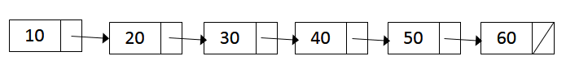
Searching in a Linked List
int search(Node* head, int v)
{
Node* t = head;
while(t != NULL)
{
if(t->val == v)
return 1;
t = t->next;
}
return 0;
}

Slide 96
Recursion – Searching in a Linked List
int search(Node* head, int v)
{
Node* t = head;
while(t != NULL)
{
if(t->val == v)
return 1;
t = t->next;
}
return 0;
}
int search(Node* head, int v)
{
if(head == NULL)
return 0;
if(head->val == v)
return 1;
return search(head->next, v);
}

Slide 97
Recursion – Print a Linked List
void print(Node* head)
{
Node* t = head;
while(t != NULL)
{
printf(“%d -> ”, t->val);
t = t->next;
}
printf(“\n”);
}
void print(Node* head)
{
if(head != NULL)
{
printf("%d -> ", head->val);
print(head->next);
}
}

Slide 98
Recursion – Print a Linked List in Reverse
void print(Node* head)
{
if(head != NULL)
{
print(head->next);
printf("%d -> ", head->val);
}
}

Slide 99
Reverse a Linked List
Source: https://www.geeksforgeeks.org/reverse-a-linked-list/
Node* reverse(Node* head)
{
Node* cur = head;
Node* prev = NULL;
Node* next = NULL;
while(cur != NULL)
{
next = cur->next;
cur->next = prev;
prev = cur;
cur = next;
}
return prev;
}

Slide 100
Removing from a Linked List
while(cur != NULL)
{
if(cur->val == v)
{
prev->next = cur->next;
free(cur);
cur = prev->next;
}
else
{
prev = cur;
cur = cur->next;
}
}
return head;
}
Node* removeNodes(Node* head, int v)
{
Node* cur = head;
while(cur != NULL && cur->val == v)
{
head = head->next;
free(cur);
cur = head;
}
Node* prev = cur;
cur = cur->next;

Slide 101

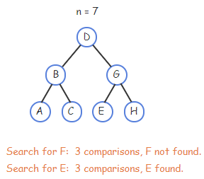

Searching – Linked List vs BST
Linear search time – N
Binary search time – logN

Slide 102
Binary Search Tree Node Structure
Node structure consists of 3 things – value (mostly int), link to left child and right child.
BST is referred by the ‘root’ node similar to the ‘head’ in a linked list.
typedef struct BSTNode
{
int val;
struct BSTNode* left;
struct BSTNode* right;
} BSTNode;
BSTNode* root;

Slide 103
BST Create New Node
BSTNode* createNode(int v)
{
BSTNode* n = (BSTNode*)malloc(sizeof(BSTNode));
n->val = v;
n->left = NULL;
n->right = NULL;
return n;
}
// Main function
BSTNode* root;
BSTNode* n1 = createNode(1);
BSTNode* n2 = createNode(2);

Slide 104
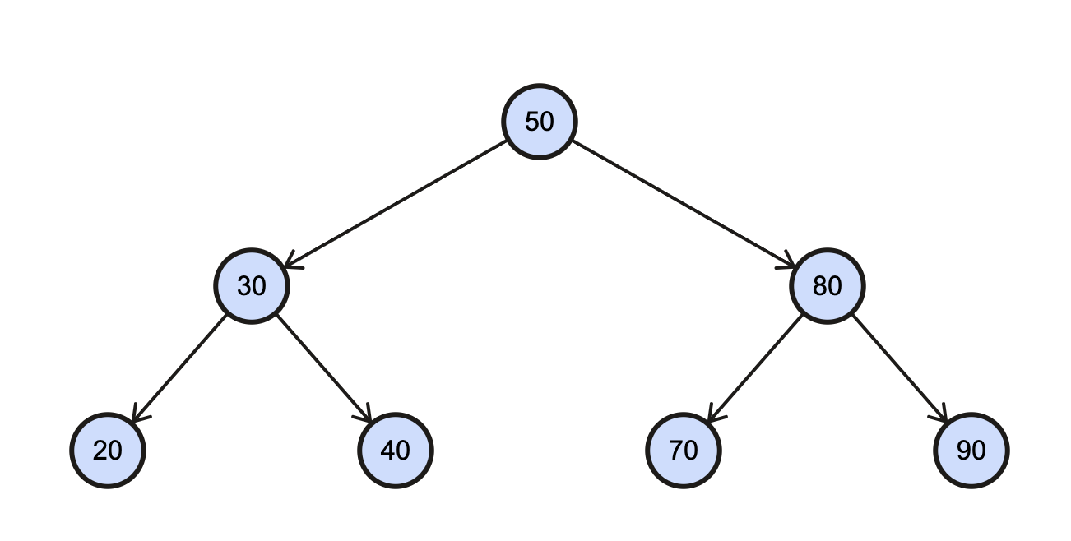
BST Traversal
void traverse(BSTNode* root)
{
/* base case – moved beyond a leaf */
if(root == NULL)
return;
traverse(root->left); /* traverse left */
traverse(root->right); /* traverse right */
}

Slide 105
Binary Search Tree Traversal Order
When traversing a BST, there are three orders in which the values can appear:
Inorder: left subtree, root, right subtree
Preorder: root, left subtree, right subtree
Postorder: left subtree, right subtree, root
When we refer to the root in this traversal order, we mean the root of the current subtree (i.e., current node) in which we are accessing/print its data.
zyBooks only covers inorder
NEED to know all 3 traversals

Slide 106
BST Traversal – InOrder, PreOrder, PostOrder
void traverse(BSTNode* root)
{
if(root == NULL)
return;
traverse(root->left);
traverse(root->right);
}
void printInOrder(BSTNode* root)
{
if(root == NULL)
return;
printInOrder(root->left);
printf(“%d ”, root->val);
printInOrder(root->right);
}
void printPreOrder(BSTNode* root)
{
if(root == NULL)
return;
printf(“%d ”, root->val);
printPreOrder(root->left);
printPreOrder(root->right);
}
void printPostOrder(BSTNode* root)
{
if(root == NULL)
return;
printPostOrder(root->left);
printPostOrder(root->right);
printf(“%d ”, root->val);
}

Slide 107
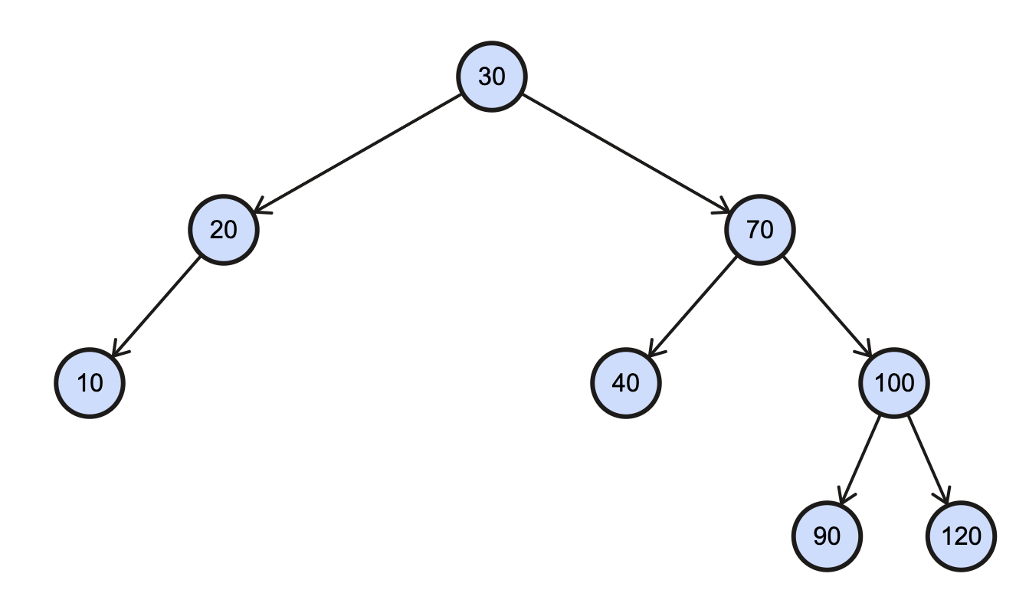
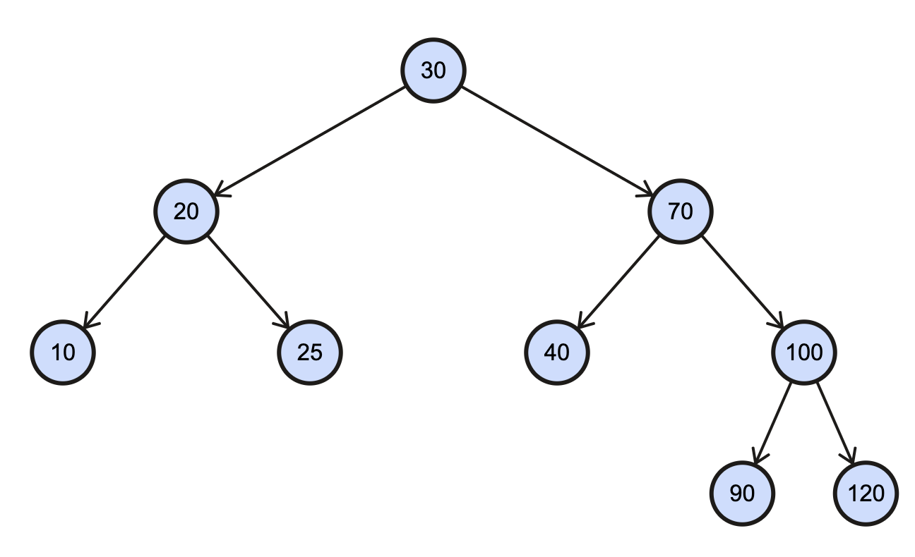
BST Insertion
BSTNode* insertNode(BSTNode* root, BSTNode* n)
{
if(root == NULL)
return n;
else if(root->val >= n->val)
root->left = insertNode(root->left, n);
else
root->right = insertNode(root->right, n);
return root;
}
INSERT -- 25

Slide 108
BST Searching
BSTNode* search(BSTNode* root, int v)
{
if(root == NULL || root->val == v)
return root;
else if(root->val > v)
return search(root->left, v);
else
return search(root->right, v);
}
SEARCH -- 90

Slide 109
BST Destroy
BSTNode* destroyBST(BSTNode* root)
{
if(root == NULL)
return NULL;
root->left = destroyBST(root->left);
root->right = destroyBST(root->right);
free(root);
return NULL;
}

Slide 110

BST Removal – Case 1 (Leaf)
Remove [90]
[90] is a leaf, so deallocate and set to NULL.

Slide 111
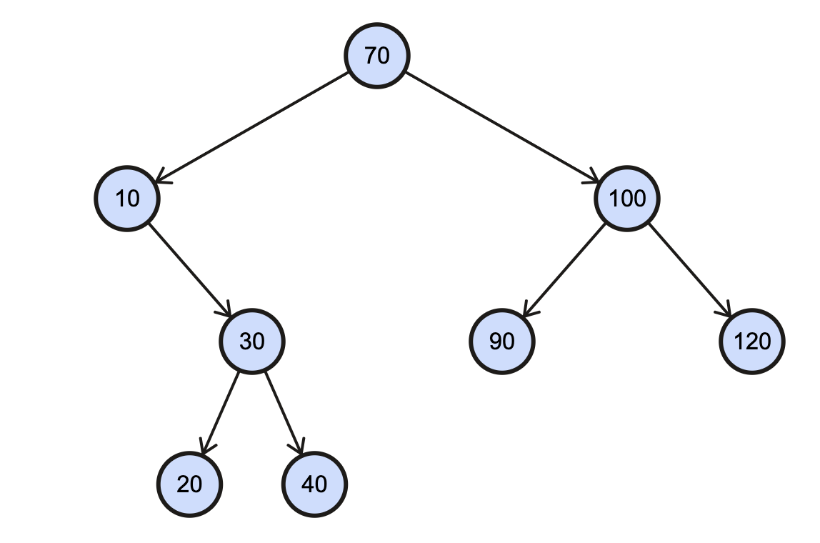
BST Removal – Case 2 (No Left Child)
Remove [10]
[10] has no left child. Deallocate [10] and its right child [30] subtree will take its place.

Slide 112
BST Removal – Case 3 (No Right Child)
Remove [20]
[20] has no right child. Deallocate [20] and its left child [10] subtree will take its place.

Slide 113
BST Removal – Case 4 (Internal Node with Both Children)
Remove [70]
[70] is an internal node. Go to the right child and then go far left as possible in that subtree. [90] replaces [70].

Slide 114
BST Removal – Find Left Most Child
BSTNode* findLeftMostChild(BSTNode* root)
{
if(root == NULL)
return NULL;
else if(root->left != NULL)
return findLeftMostChild(root->left);
return root;
}

Slide 115
BST Removal
else if(root->left == NULL || root->right == NULL)
{
BSTNode* tmp;
if(root->left == NULL)
tmp = root->right;
else
tmp = root->left;
free(root);
return tmp;
}
else
{
BSTNode* tmp = findLeftMostChild(root->right);
root->val = tmp->val;
root->right = removeNode(root->right, tmp->val);
}
}
return root;
}
BSTNode* removeNode(BSTNode* root, int v)
{
if(root == NULL)
return NULL;
if(root->val > v)
root->left = removeNode(root->left, v);
else if(root->val < v)
root->right = removeNode(root->right, v);
else
{
if(root->left == NULL && root->right == NULL)
{
free(root);
return NULL;
}

Slide 116
BST – Other Functions
Count() – returns the total number of nodes in the tree – iterative/recursive
Sum() – returns the sum of all the node values in the tree – iterative/recursive
CheckEqualTrees() – returns TRUE if two trees (or subtrees) are equal, i.e. same shape and values for all the corresponding nodes – iterative/recursive

Slide 117
Sample Final Exam
CS 1714 – Computer Programming II

